Slide 1
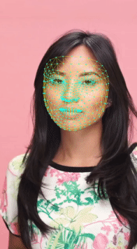
3D Face reconstruction (FaceMesh model)
Presented by: Ahmed Ezzat

Slide 2
Understanding 3D Face Reconstruction
3D Face Reconstruction is The process of converting 2D facial data into accurate 3D models using advanced algorithms
FaceMesh simplifies 3D reconstruction with lightweight real-time applications powered by Machine Learning.
FaceMesh is pioneering due to innovative landmark detection across 468 facial points ensures precision and realism.

Slide 3
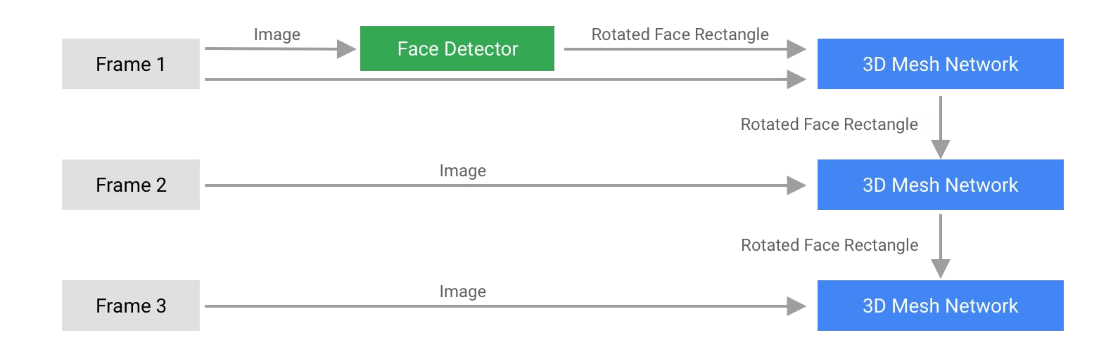
MediaPipe FaceMesh: ML Pipeline
Two ML models:
MediaPipe pipeline: BlazeFace Detector + 3D FaceMesh network
BlazeFace returns oriented ROI
3D Mesh network predicts mesh from ROI crop
FaceMesh model to re-use ROI from previous frame
BlazeFace only runs on 1st frame or when mesh indicates face miss

Slide 4
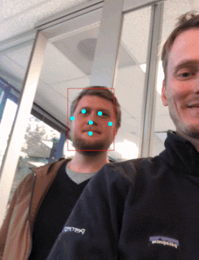
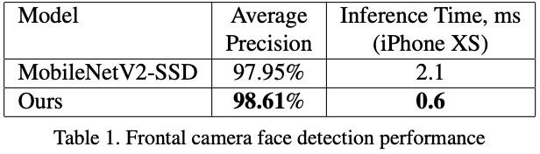
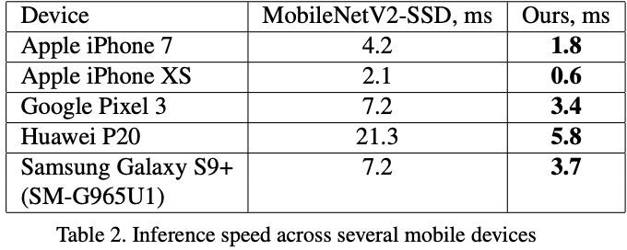
BlazeFace: Sub-millisecond Face Detection
Predicts face rectangle + 6 landmarks
Optimized for selfie uses / mobile use cases
Leverages tflite GPU, XNNPack for tflite CPU and tf.js
Paper, Web Page
Powers all FaceMesh applications

Slide 5
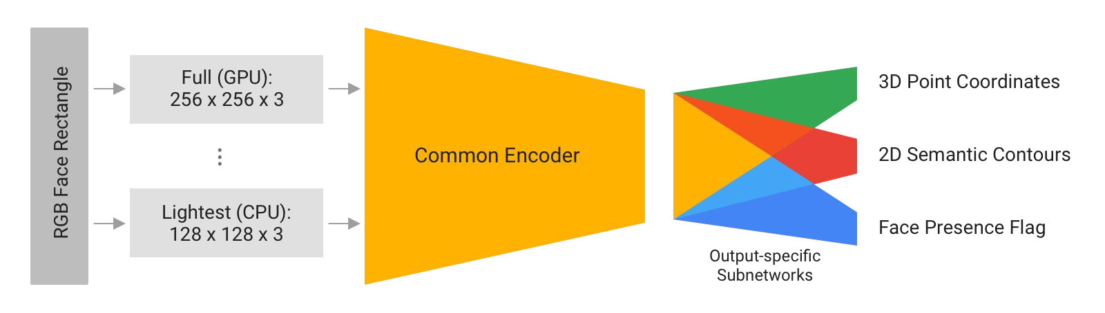
FaceMesh: Design Elements
Predicts 486 3D landmarks from ROI cropped+rotated face detection
Uses regression over heatmaps
Tight detector coupling:
Limits cropping augmentation
Predicts face presence in ROI crop -> trigger detection
Trained on 3 datasets: 2D contours + Real world mesh + synthetic mesh
Paper

Slide 6
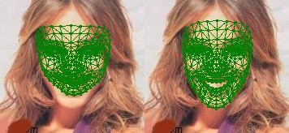
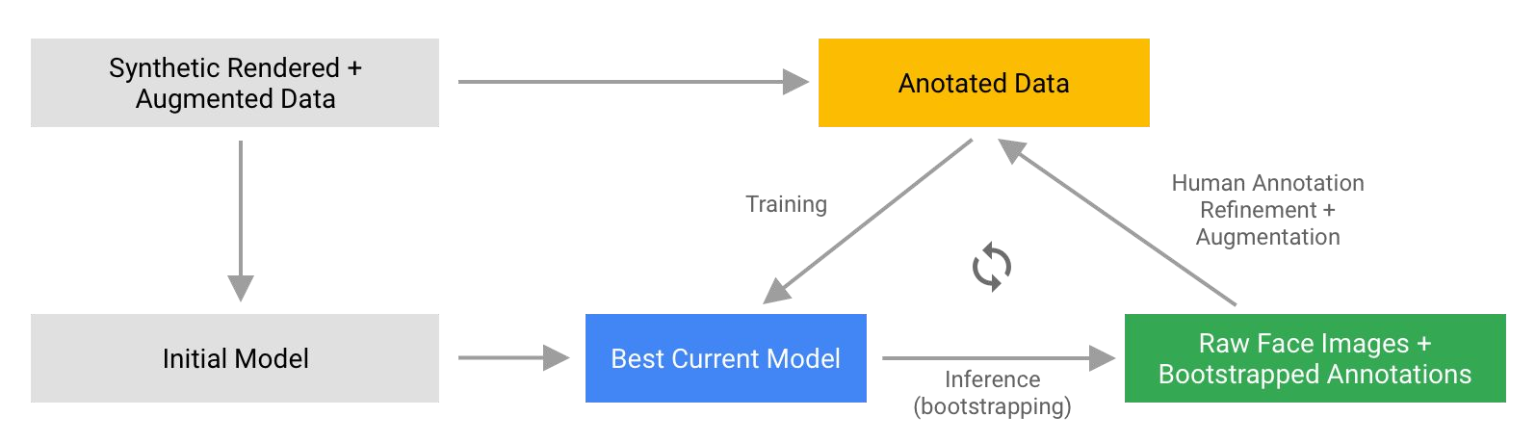
FaceMesh: Annotation challenge
Annotating high-fidelity landmarks from scratch is hard!
Bootstrap approach:
a) Train initial model from 2D contours + synth. data
b) Refine bootstrapped annotations w/ humans in the loop
Synth data only
2D contours + synth

Slide 7
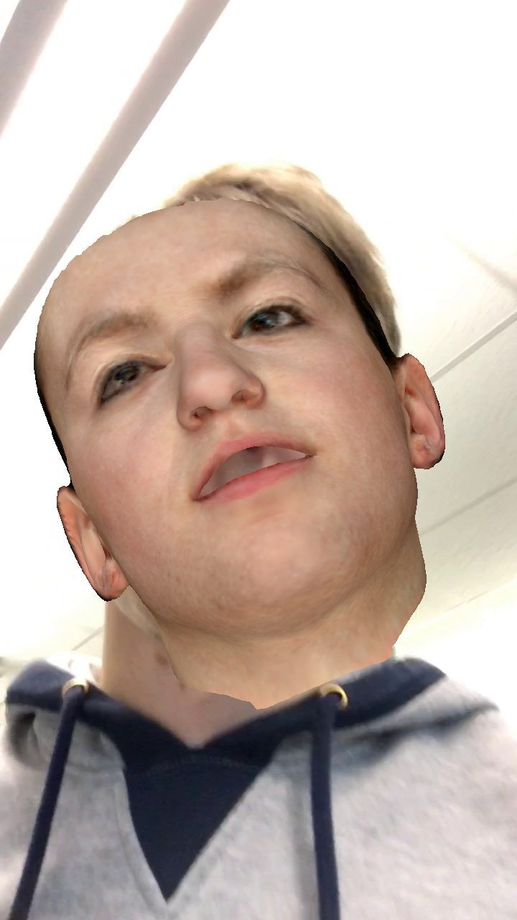
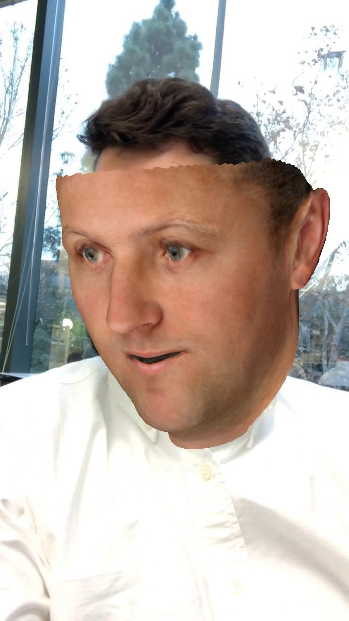
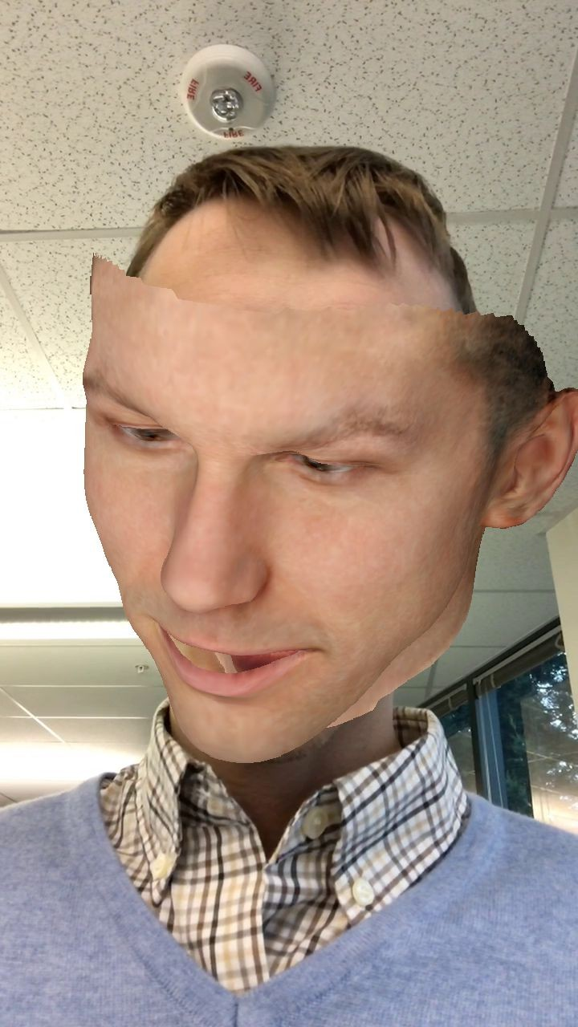
FaceMesh: Synthetic data
10K synthetic Basel images rendered onto real photos
Ground truth: 3D points via mapped mesh
Initial model: RGB → 3D points

Slide 8
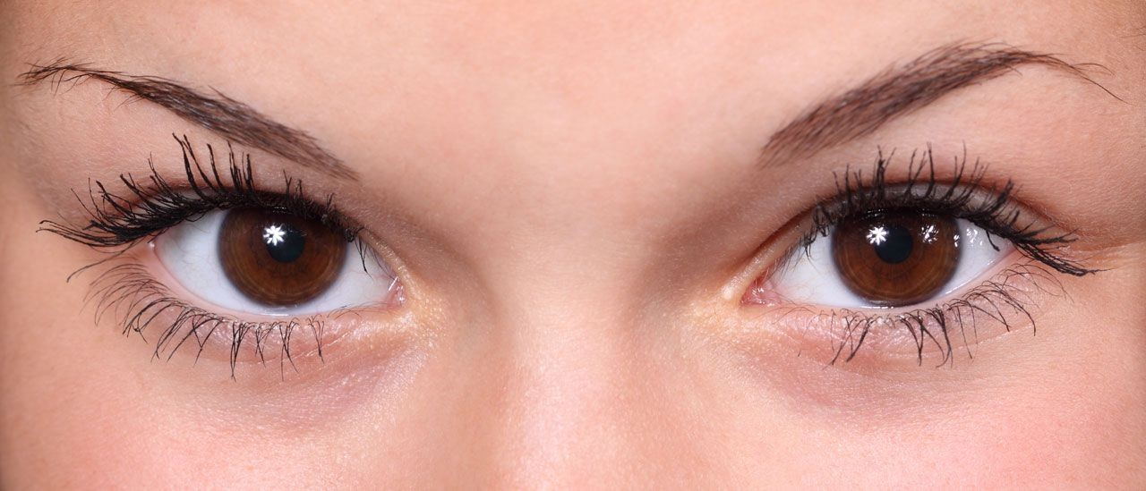


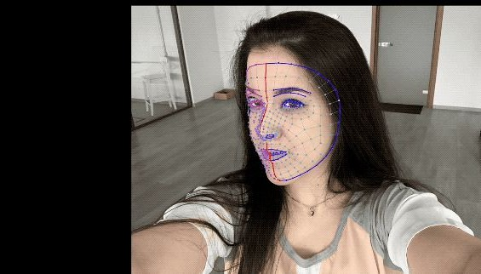
FaceMesh: Real world data
IOD sstimats
Refinement of face contours via custom tool
Build up dataset of 30K GT images
Human annotation discrepancy:
2.56% IOD - Interocular distance
~5 min per image

Slide 9
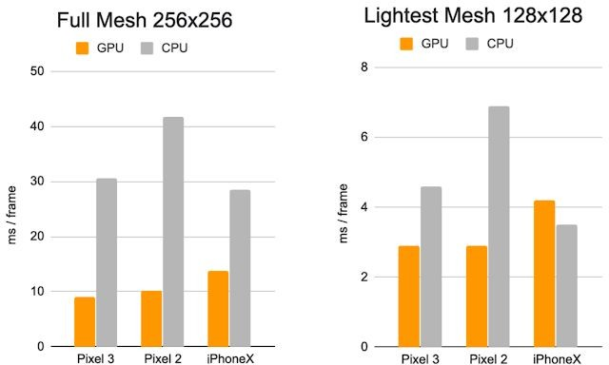
FaceMesh: Performance
Two models: Full and lite
Accuracy similar to humans (2.56%), Ranging from 2.44% - 3.5% IOD across regions

Slide 10
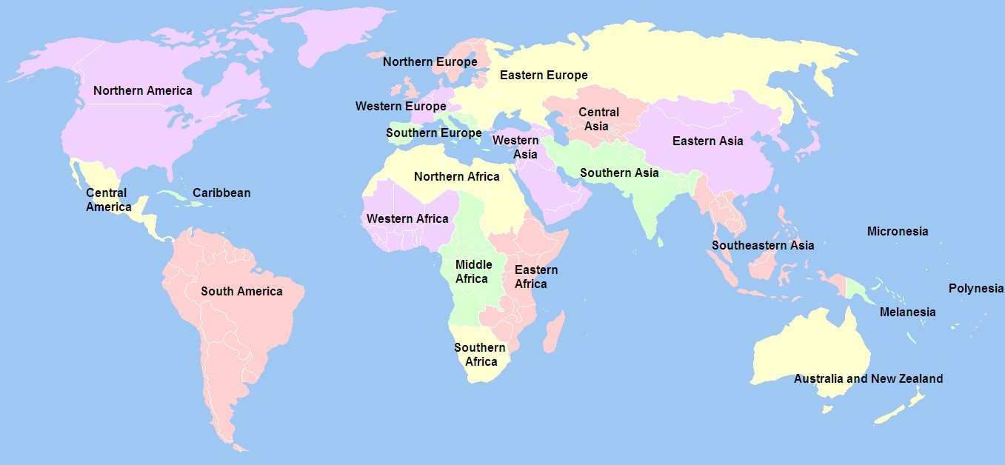
ML Fairness
Test datasets have equal representation of 17 geographical regions, as defined by UN
We consider a model to be performing unfairly across representative subsets of the overall population if the error range on them spans more than the human annotation discrepancy
Human discrepancy: 2.56% IOD MAE
FaceMesh range 2.44% (N Africa) - 3.5% (N America)
Delta: 1.06 % << Human discrepancy
Results published in MediaPipe FaceMesh Model Cards
Evaluation Regions

Slide 11
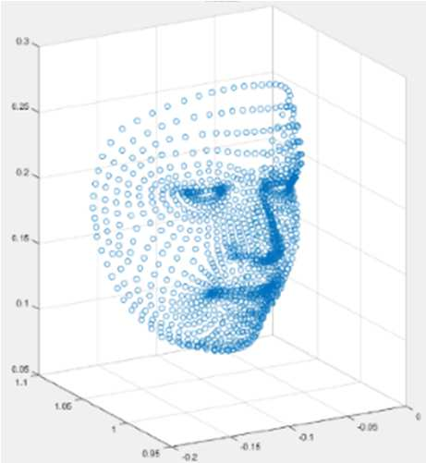
Challenges and Limitations
Computational Constrains: Performance may degrade in low-powered devices despite optimizations.
Accuracy Issues: Challenges in capturing fine details and handling occlusions.
Environmental Factors: Lighting and camera quality significantly affect results.

Slide 12
Resources
Google AI Blog: FaceMesh
FaceMesh : Detecting Key Points on Faces in Real Time
Real-time Facial Surface Geometry from Monocular Video on Mobile GPUs
MediaPipe Face Mesh
Face landmark detection guide

